Slide 1


Troubleshooting Distributed Systems with Minimal Causal Sequences
Colin Scott, Andreas Wundsam, Barath Raghavan, Andrew Or, Jefferson Lai, Eugene Huang, Zhi Liu, Ahmed El-Hassany, Sam Whitlock, Hrishikesh B. Acharya, Kyriakos Zarifis, Scott Shenker
Notes:
Quick intro to SDN: this is a tech talk tomorrow at a startup that’s going to be adopting our system. They’re actually building production controllers, so the expectation is that they know this stuff. To anyone here who doesn’t know it: 15 second intro to SDN.
You’re welcome to interrupt me throughout

Slide 2
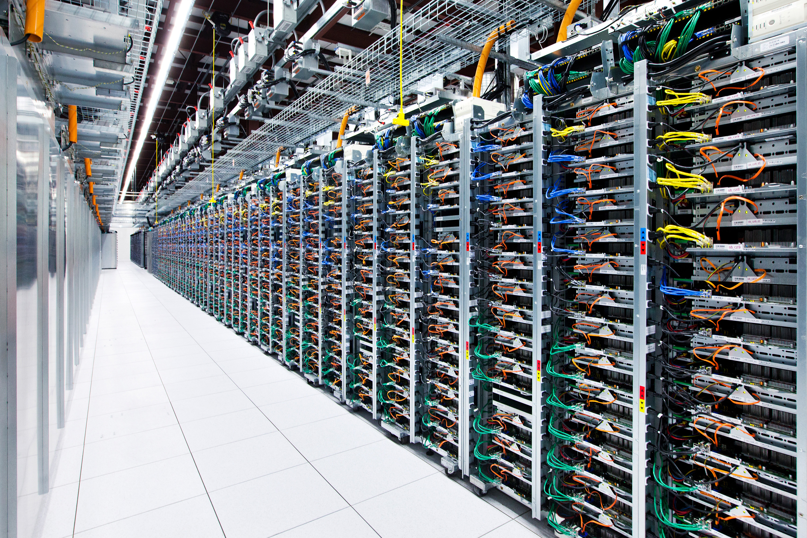

Slide 3
How many events in a datacenter network?
= ~500 events / minute

Slide 4

Something goes wrong!

Slide 5
Best practice: Logs
Human analysis of log files

Slide 6
Best practice: Logs
?
Controller A
Switch 1
Switch 2
Switch3
Controller B
Switch 4
Switch 5
Switch 6
Controller C
Switch 7
Switch 8
Switch 9

Slide 7
Goal
Identify the minimal set of events that trigger the bug

Slide 8
Minimal Causal Set
Crash
Master
Ping
Pong
Ping
…
Backup
Master
Link Down!
Not Master...
Link Down!
Blackhole persists!
Switch
Link Failure
Notes:
To here?

Slide 9
Minimal Causal Set
?
Controller A
Switch 1
Switch 2
Switch3
Controller B
Switch 4
Switch 5
Switch 6
Controller C
Switch 7
Switch 8
Switch 9
Notes:
OK, so how are we going to get from here…

Slide 10
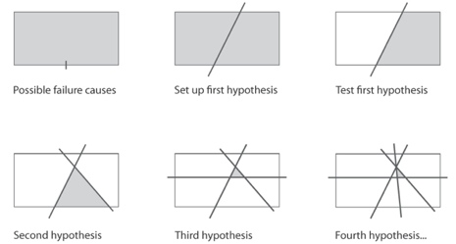
High-Level Approach
Modify history!

Slide 11
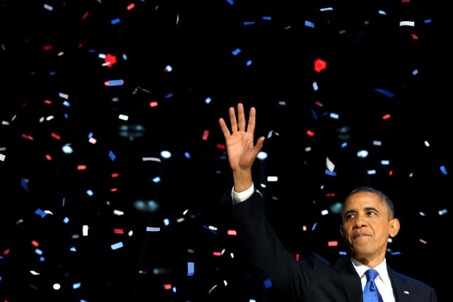
Replaying Altered History is Hard

Slide 12
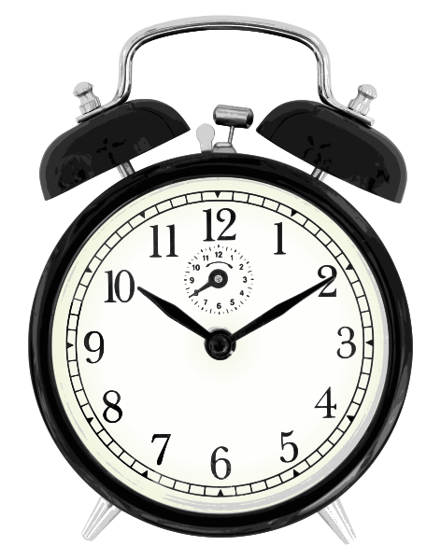

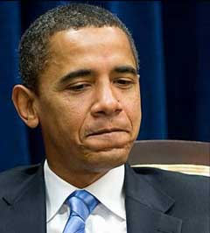
Need to Reason About Equivalence!

Slide 13
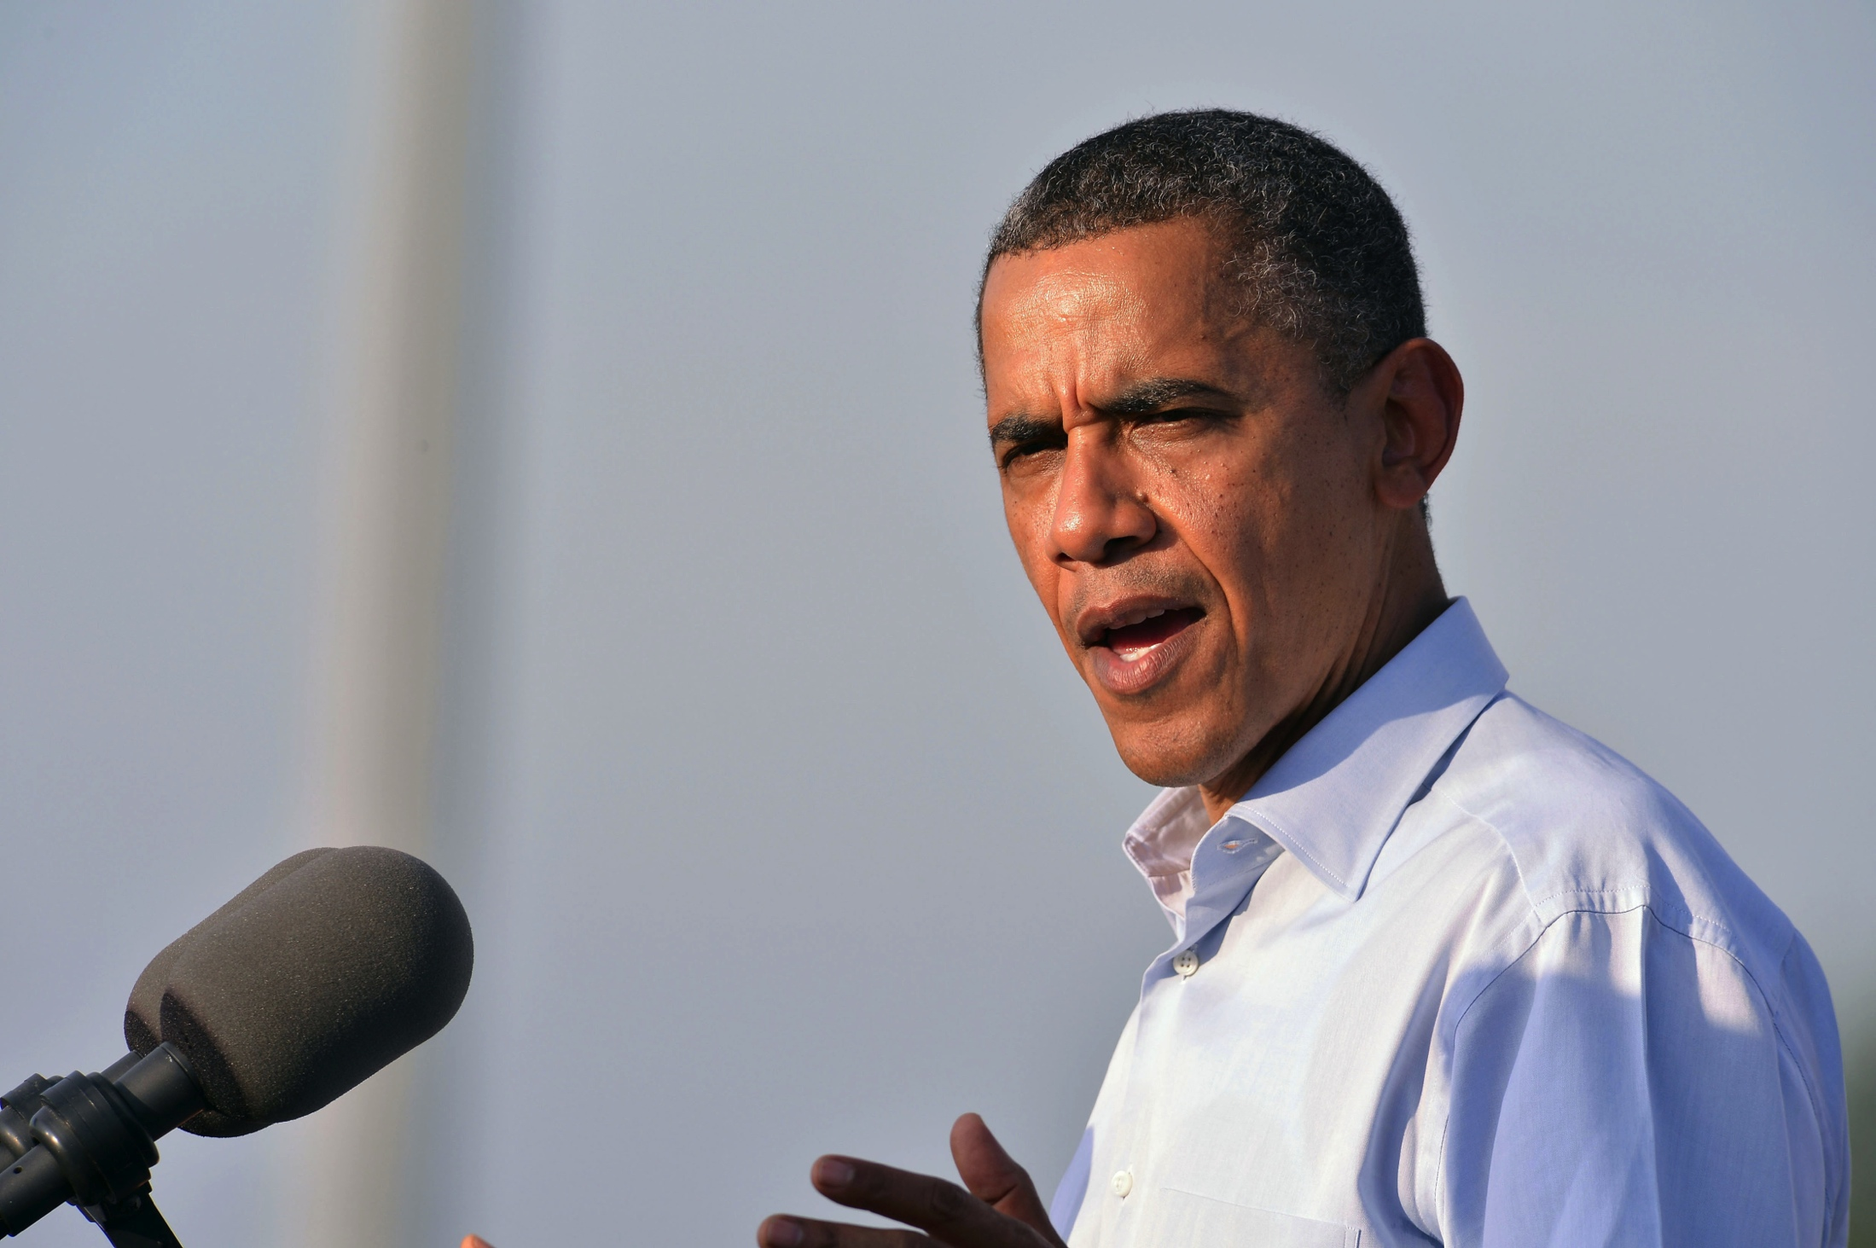
But usually it doesn’t affect the result

Slide 14
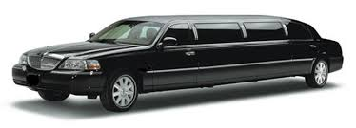
Need to Reason About Equivalence!
≈

Slide 15
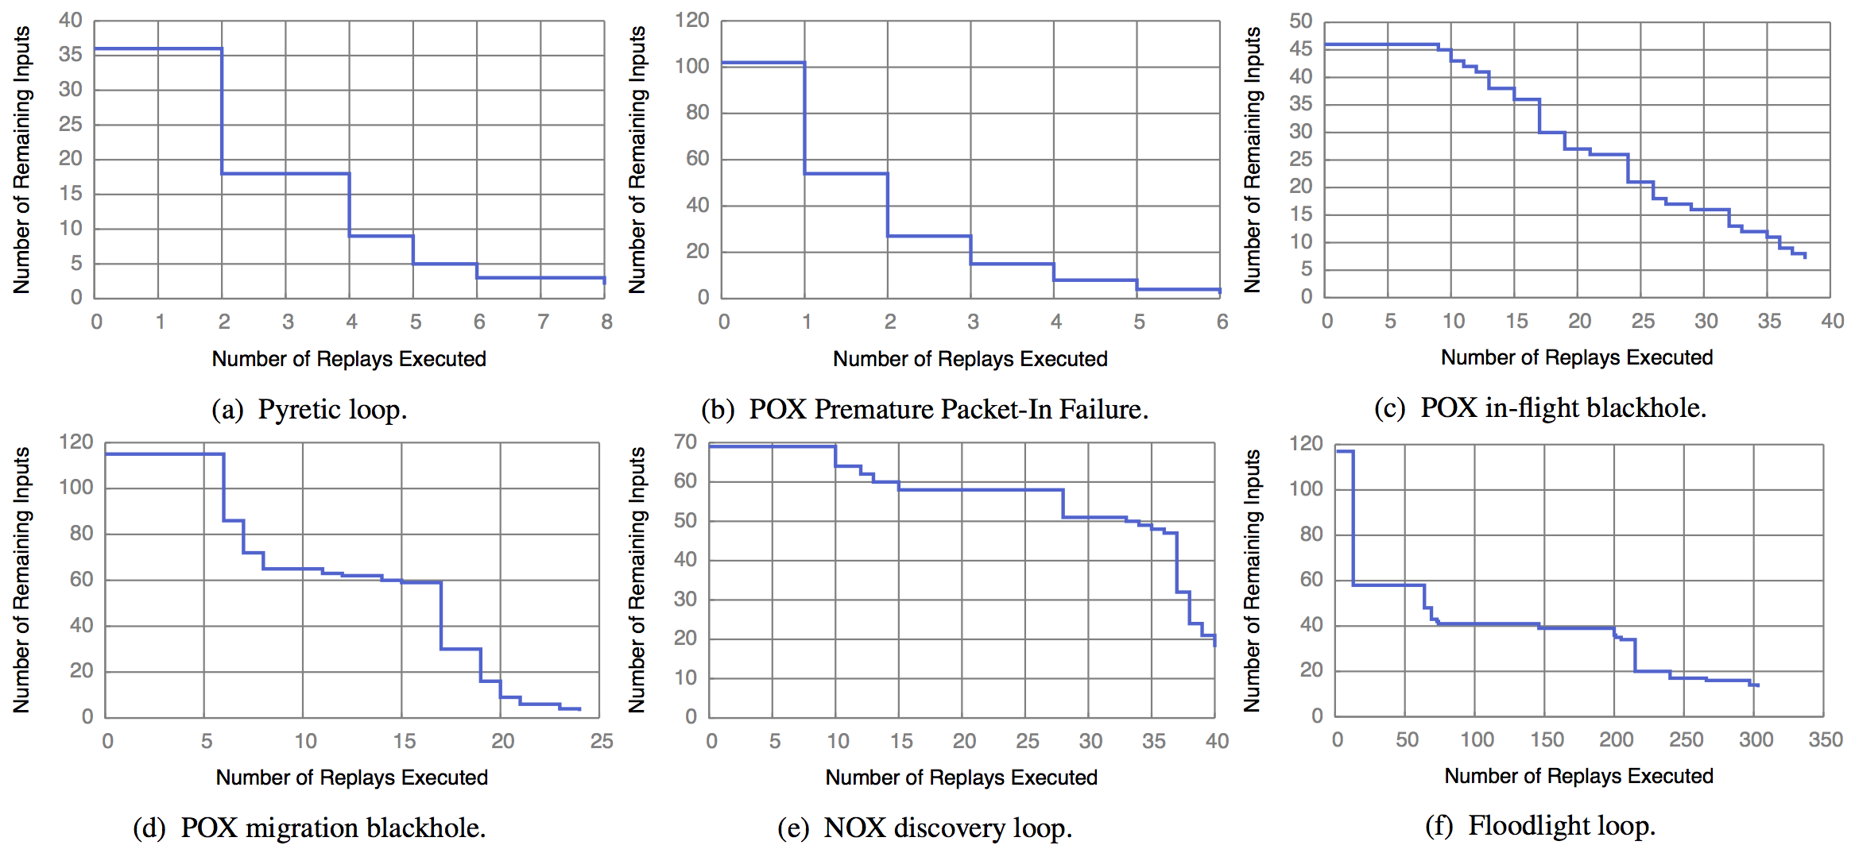
It Works!

Slide 16
Summary
Goal: isolate minimal causal sequences
We built a real system (21K+ lines of Python) that works on real SDN controllers (Floodlight, NOX, POX, Frenetic, ONOS) including one proprietary controller
Check us out:
ucb-sts.github.com/sts/

Slide 17
Backup

Slide 18
References
[1] V. Soundararajan and K. Govil. Challenges in building scalable virtualized datacenter management. SIGOPS Operating Systems Review ’10.
[2] A. Greenberg, J. R. Hamilton, N. Jain, S. Kandula, C. Kim, P. Lahiri, D. A. Maltz, P. Patel, and S. Sengupta. VL2: a scalable and flexible data center network, Sec. 3.4. SIGCOMM ’09.

Slide 19
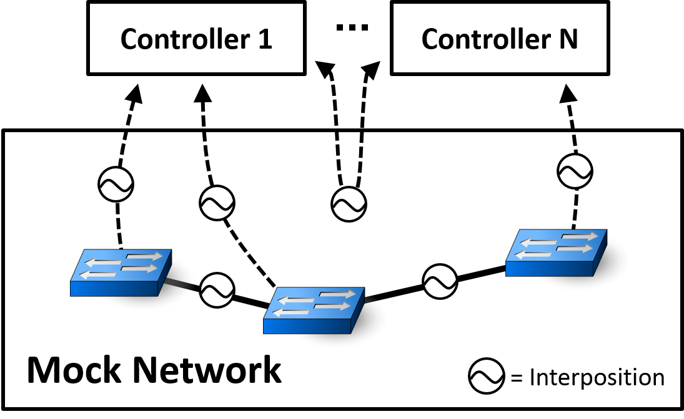
Simulator
Notes:
This is a really high-level depiction of our system. Essentially what we’re going to do is simulate the entire execution of the physical network. In a single process, we model switches in the network. We then run control servers on top of this, but we interpose on all of the communication channels.
Mechanisn to explore those research questions! Not a software artefact….
Mark properties: delay, re-ordering, failure modes, ….

